Slide 1

Real Estate Market
The impact of COVID-19 in Ontario’s Real Estate Market
Authors:
Emilia Lubanska, Jorge Arriola, Marina Ercoli, Monica Lin, Ulisses Pinto

Slide 2
Motivation & Summary
Goal & Hypothesis
To analyse the impact of Covid-19 on the real estate market comparing 2019 and 2020 data from Ontario.
We believe that indicators related to the real estate market will have a lower performance in 2020 than in 2019. (e.g. less houses sold in 2020 than in 2019)
Questions
What are the number of Covid-19 cases reported in Ontario? How has this number changed throughout 2020?
What is the impact of Covid-19 on the real estate market?
Does it impact the interest rates?
Is there any correlation between Covid-19 and the number of houses sold?
What about price fluctuation?

Slide 3

Data Sources
Canada Mortgage and Housing Corporation, housing under construction in all centres 10,000 and over for Canada, provinces, and selected census metropolitan areas (Type: CSV) https://open.canada.ca/data/en/dataset/1995a476-68fd-4fe2-973f-2dd47f7f6c2c
Confirmed positive cases of COVID19 in Ontario (Type: CSV)
https://data.ontario.ca/dataset/confirmed-positive-cases-of-covid-19-in-ontario/resource/455fd63b-603d-4608-8216-7d8647f43350
Average, Median and Price Percentiles for Unabsorbed Homeowner and Condominium Units (Provinces) – Ontario (Type: API)
https://www.quandl.com/api/v3/datasets/CMHC/HPPA50_ON.json?api_key=9aGzLsxCKNH7a9NEiKi5
Canadian Interest Rates and Monetary Policy Variables: 10-Year Lookup (Type: CSV)
https://www.bankofcanada.ca/rates/interest-rates/canadian-interest-rates/

Slide 4
Data Cleanup & Exploration
Cleanup process
Based on the main data frame, create a new chart that only includes the information we need
Retrieve Data
Create data frames
Note: We all agreed to create a column named ‘Date’ with the same format for all datasets. Allowing us to grouping the datasets easily.

Slide 5
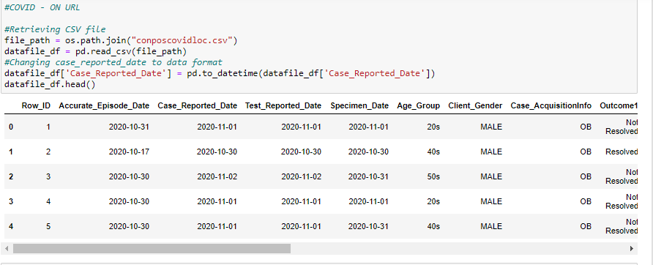
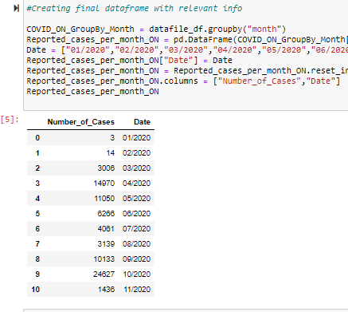
Data Cleanup
Before: Covid-19 cases in Ontario table
After: Number of Covid-19 cases in Ontario per month

Slide 6
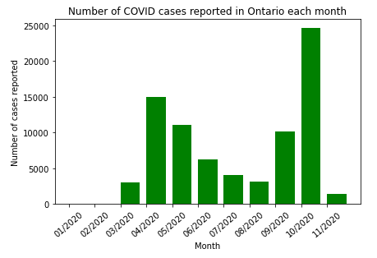
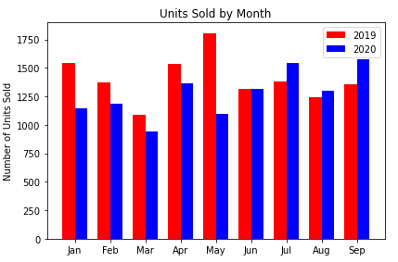
Analysis – Part 1→ We plot the information we retrieved from our datasets
Number of Covid-19 cases in Ontario
Number of units (i.e. houses) sold in Ontario
Observation: We can clearly notice the two Covid-19 ‘waves’ in April and October
Observation: We notice that the number of houses sold has not significantly decreased throughout 2020

Slide 7
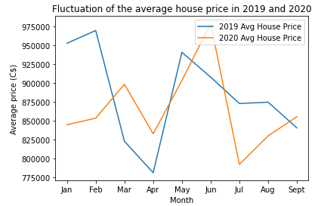
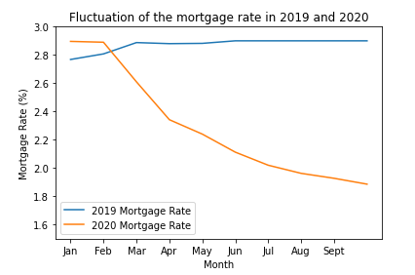
Analysis – Part 1→ We plot the information we retrieved from our datasets
House prices in 2019 vs. 2020
Mortgage rate in 2019 vs. 2020
Observation: There is a decrease in the average house price in July 2020.
Question: Is it correlated with COVID-19 cases?
Observation: It is clear that the mortgage rate is lower in 2020 vs. 2019

Slide 8
Analysis – Part 1→ We plot the information we retrieved from our datasets
House prices in 2019 vs. 2020
Mortgage rate in 2019 vs. 2020
Observation: There is a decrease in the average house price.
Question: Is it correlated with COVID-19 cases?
Observation: It is clear that the mortgage rate is lower in 2020 vs. 2019

Slide 9
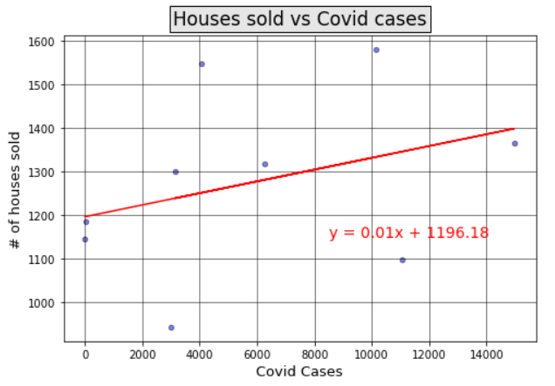
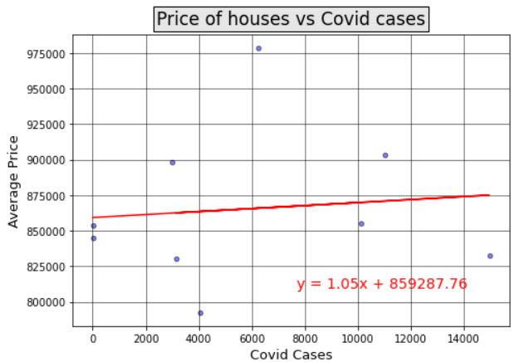
Analysis – Part 2→We determine if there is a correlation between the number of reported Covid-19 cases and the real estate variables
Regression analysis of number of houses sold and Covid-19 cases
Regression analysis of price of houses and Covid-19 cases
Correlation coefficient: 0.34
There is a weak correlation between the number of Covid-19 cases reported each month and the monthly number of houses sold in Ontario throughout 2020
Correlation coefficient: 0.1
There is a very weak correlation between the monthly changes in Covid-19 cases and the number of houses sold in Ontario throughout 2020

Slide 10
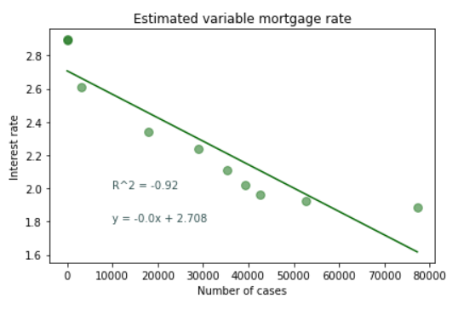
Analysis – Part 2→We determine if there is a correlation between the number of reported Covid-19 cases and our real estate variables
Regression analysis of mortgage rate and Covid-19 cases
Correlation coefficient: -0.92
There is a strong negative correlation between the cumulative number of Covid-19 cases in Ontario, and the mortgage rate

Slide 11
Findings: The behavior of 2020 real estate indicators in Ontario cannot be clearly explained by only looking at the progression of Covid-19
1. Number of houses sold:
Visual inspection: The monthly number of houses sold in Ontario in 2019 and 2020 are very similar.
Regression analysis: With a correlation coefficient of 0.34, there is a weak correlation between the monthly changes in Covid-19 cases and the monthly number of houses sold.
2. Average price of houses:
Visual inspection: There are fluctuations in the average price of houses. The lowest point of this value in 2020 was in July. There is no clear trend visible.
Regression analysis: With a correlation coefficient of 0.1, there is a weak correlation between the monthly changes in Covid-19 cases and the monthly average price of house in Ontario.
3. Mortgage rate:
Visual inspection: The mortgage rate is lower in 2020 than in 2019. This may be a response from banks to the impact of Covid-19.
Regression analysis: With a correlation coefficient of -.92, there is a strong correlation between the cumulative increase of Covid-19 cases and the downward trend of the mortgage rate

Slide 12

Post Mortem
Difficulties that arose, and how we dealt with them:
………
……….
Additional questions | What would we research next?
………
……….

Slide 13
Thank You!
Our photo to be added
Covid-19
Emilia Lubanska, Jorge Arriola, Marina Ercoli, Monica Lin, Ulisses Pinto

